Slide 1



AUTOMATED CHEQUE PREPROCESSING
THOSE IT GUY'S

Slide 2

ABSTRACT
A Brief Information About Our Project
CONTENTS
PROPOSED SYSTEM & REQUIREMENTS
Features Of Our Prototype And Requirements
PROS AND CONS
Advantages,Disadvantages And Application

Slide 3
ABSTRACT
Despite of swift advancements happening in digital technology, financial institutions likebanks still rely upon conventional medium of processing the bank cheques by humans. The process is cumbersome and takes couple of days for actual transfer of money which involves verification by the intermediaries. This leads to high time and costs.

Slide 4
ABSTRACT
In this paper, we propose an automated system which extracts relevant details of a bank cheque like Payee Name, Amount, Date, Bank Name using Optical Character Recognition and Deep Learning and verifies the signature on the cheque with the existing signature stored in the database using feature extraction and principal component analysis. Thesignature for a new user is stored using it’s hash value for security purposes.

Slide 5
ABSTRACT
The proposed system uses modified convolution neural network to extract the handwritten content on cheque leaf where in IAM dataset is used to train the model and get the optimized results. This system will facilitate the process and lead to reduction intime and costs. The efficiency and performance is measured .

Slide 6


PROPOSED SYSTEM
The proposed system uses modified convolution neural network to extract the handwritten content on cheque leaf where in IAM dataset is used to train the model and get the optimized results. This system will facilitate the process and lead to reduction intime and costs. The efficiency and performance is measured

Slide 7
REQUIREMENTS
HARDWARE REQUIREMENTS
SOFTWARE REQUIREMENTS
i3 Processor Based Computer or higher
Memory: 4 GB RAM
Hard Drive: 256 GB
Monitor
Scanner
MATLAB Version R2013a
Operating system: Windows 7 and above

Slide 8
SYSTEM DESIGN
HAND PROCESSING RECOGNITION
PREPROCESSING
DISADVANTAGES
Some preprocessing is applied on the image to reduce noise. There are some common methods of preprocessing: Smooth, Dilate, Erode, Median, Open, Close etc
After preprocessing hand writing recognition is used to find the amount written on cheque, it recognizes the digits and stores in an array and we have verified it with the database for the gaining information on the account balance and process the transaction.

Slide 9
SYSTEM DESIGN
SIGNATURE VERIFICATION
POST PROCESSING:
DISADVANTAGES
An image of a signature or a direct signature is fed into the signature verification software and compared to the signature image on file. Signature verification is often used to compare signatures in bank offices and other branch capture.This step is important in the processing of cheque.
Post-processing deals with the process of combining the individual digits into complete number for account number, date and amount. Using simple mathematical formula which is used to reverse the number, the complete number is constructed.

Slide 10
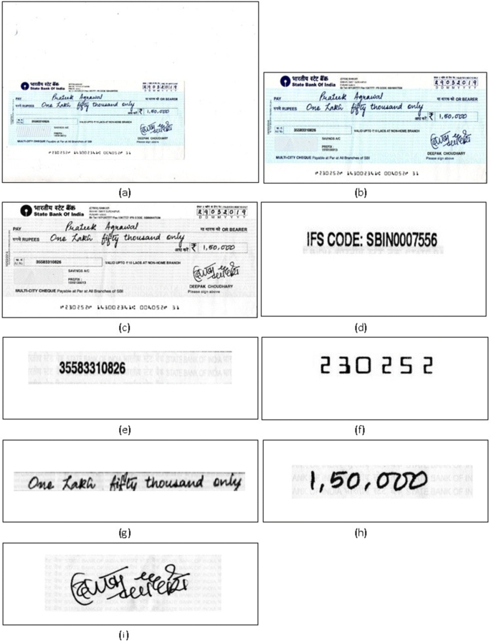
ANALYSIS
RESULT

Slide 11
CONCLUSION
We have developed the model to verify the bank cheques using OCR, CNN, SIFT and SVM. We have used OCR method to identify the machine typographic characters with desirable accuracy and efficiency, whereas, we have performed CNN to give precise output for the handwritten digits written on the cheque leaflet. We have proposed and implemented the algorithm to convert numbers into words to verify the cheque which is one of the major reasons of its bounce-off and of halt the monetary transaction.

Slide 12
CONCLUSION
In order to achieve this, We have applied OCR technique to recognize the machine printing digits and achieved 95% accurate matching. Then, separate database is used to train the network and after achieving a desired level of accuracy after training, we have used different data sets to test the trained model for matching the numbers into the words. Evidently, achieved an accuracy of 99.14% for the digit recognition which is an improvement over the previous accuracy of 99.05% for the CNN used for digit recognition.

Slide 13
CONCLUSION
In order to achieve this, We have applied OCR technique to recognize the machine printing digits and achieved 95% accurate matching. Then, separate database is used to train the network and after achieving a desired level of accuracy after training, we have used different data sets to test the trained model for matching the numbers into the words. Evidently, achieved an accuracy of 99.14% for the digit recognition which is an improvement over the previous accuracy of 99.05% for the CNN used for digit recognition.

